Slide 1

Department of Computer Science, CUI Lahore Campus
Formal Methods in Software Engineering
By
Farooq Ahmad

Slide 2
Introduction to Formal Methods
Why and how to use Formal Methods

Slide 3
Topics to be discussed
Why to use formal methods?
When to apply formal methods?
How to apply formal methods?

Slide 4
Shortcomings of diagrams (informal specification)
They are unstructured and many computer scientists also tended to reject anything that looked faintly like a flowchart.
They had neither syntax nor semantics.
It is impossible to prove their formal correctness of the model of system.
Difficult to establish precise mapping rules to "transform" a specification into an algorithm or verify a program.

Slide 5
Why to use formal methods
The whole point of using formal methods is to be able to predict what a program will do without running any code - in fact, without writing any.
This ability to model behavior distinguishes the formal methods from diagrams that can only model program structure.
Formal methods can help you create software so that you can understand it before you run it.
This means we can discover many errors without having to run any tests.

Slide 6
Why to use Formal Methods: Analysis
Analysis is any activity devoted to understanding software without actually running programs - anything that involves reading, discussing, and trying to understand programs without testing.
Formal methods provide the analysis of a software.
Formal methods make it possible to derive designs and code from a specification, and to check whether code and designs correctly implement a specification.

Slide 7
Requirements analysis
Validation
Formal Specification
Verification
Design (modeling)
Verification
Coding
Testing

Slide 8
Formal analysis vs testing
What we call formal methods are just particular kinds of analyses that employ mathematical notations.
Analysis can be more effective than testing for many purposes.
Testing cannot take place until some implementation is available.
Therefore correcting errors uncovered by testing could involve retracing many steps and undoing work previously done.

Slide 9
Formal methods vs testing
Testing can only help to uncover errors – it cannot guarantee the absence of them.
On the other hand formal analysis can provide correct design and it can identify errors before implementation.

Slide 10
Where we use formal methods
We can express the specification or design in formal methods.
We also use formal notations in the stages (phases) that come before coding.
Formal methods involve writing another formal description of the program, in addition to the code itself.

Slide 11
How to use formal methods
Formal modeling
Formal design
Formal verification

Slide 12
How to use formal methods: Formal modeling
Model is a simplified representation.
We can use the formal model to calculate or infer the behavior of the program before we code it.
We construct a model to focus on some particular aspect of a system, and we omit all the details that are inessential to that aspect.
In a model-based approach an abstract mathematical model is built of the data, using abstract mathematical types such as sets.
The behavior of the operations is then specified directly with respect to this model.

Slide 13
How to use formal methods: Formal Design
Design means organizing the internal structure of a program.
Design is a particular way to draw and annotate diagrams, such as block-diagram, data flow diagram.
They can only represent the structure of a program: what the program's parts are and how they are related to each other.
Formal methods can be used at the design phase because it can also model behavior.
We can use formal methods to express precise description of components and which components of the system are needed to perform any behavior.

Slide 14
How to use formal methods: Formal verification
Verification means showing that our code will do what we intend.
One of the products of a formal verification is a proof, a convincing demonstration that the code does what its specification requires.
Proof is based only on the specification and the program text, not on executing the program.
A proof system is a means of guaranteeing the correctness of a statement and relies upon mathematical logic.

Slide 15
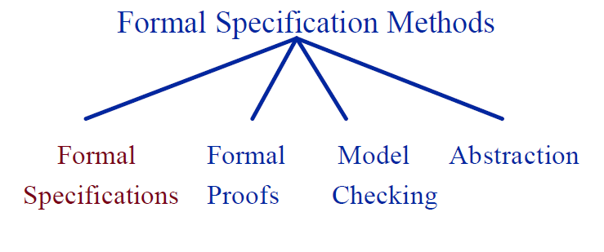
How to use Formal methods

Slide 16
Getting abstract mathematical model
Finding the best structure usually depends on understanding the behavior.
Software design describe the structural aspect of software.
Software design also describes the behavioral aspect of software.

Slide 17
Static aspect of a system
The static aspects Include:
the states of a system can occupy;
the invariant relationships that are maintained as the system moves from state to state.
In Z, schemas are used to describe both static and dynamic aspects of a system.

Slide 18
Dynamic aspects of system
Finding the best structure usually depends on understanding the behavior.
The dynamic aspects include:
the operations that are possible;
the relationship between their inputs and outputs;
the changes of state that happen.

Slide 19
Structural and behavioral diagrams
Structural UML diagrams
Class diagram
Package diagram
Object diagram
Component diagram
Composite structure diagram
Deployment diagram
Behavioral UML diagrams
Activity diagram
Sequence diagram
Use case diagram
State diagram
Communication diagram
Interaction overview diagram
Timing diagram

Slide 20
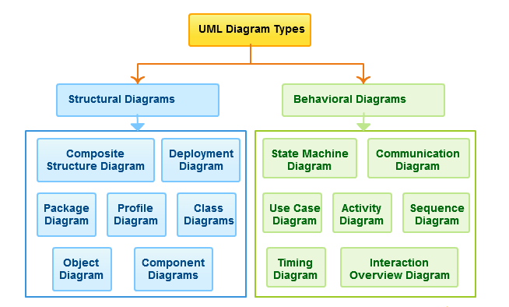
UML Diagram Types

Slide 21
Getting abstract formal model
Structural
Diagrams
Behavioral
Diagrams
Passive
Components of a system
Active
Components of a system
States
Transitions
Formal
Methods

Slide 22


Approach
Original specification
Formal Modeling
Requirements
Model checking
True
False
Counterexample

Slide 23
Summary of the lecture: conclusion
Why we use formal methods
Formal methods vs testing
How to use formal methods
Getting abstract mathematical/formal model

Slide 24
Reference and reading material
Chapter # 1: of the book “Formal Software Development, from VDM to Java” by Quentin Charatan and Aaron Kans
Chapter 1: of the book “Software development with Z” by J.B. Wordsworth

